Slide 1
Inverter testcase: SCH entry → PEX simulation
Diarmuid Collins
16.05.2025

Slide 2
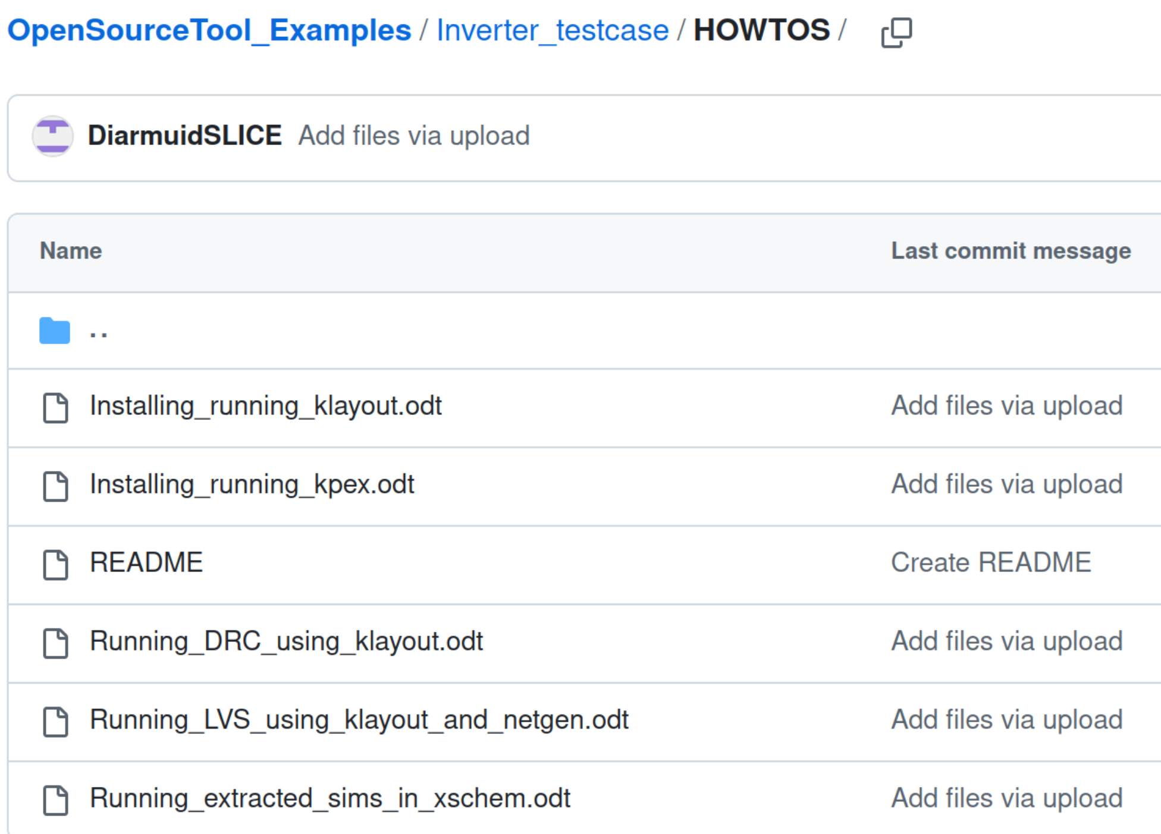
Introduction
Slides give a top level demonstration of schematic entry → PEX simulation in IHPS13G2 process
Basic inverter used as the test vehicle
Detailed docs describing each of the
stages more thoroughly can be found
at:
https://github.com/SLICESemiconductor/OpenSourceTool_Examples/tree/main/Inverter_testcase/HOWTOS

Slide 3
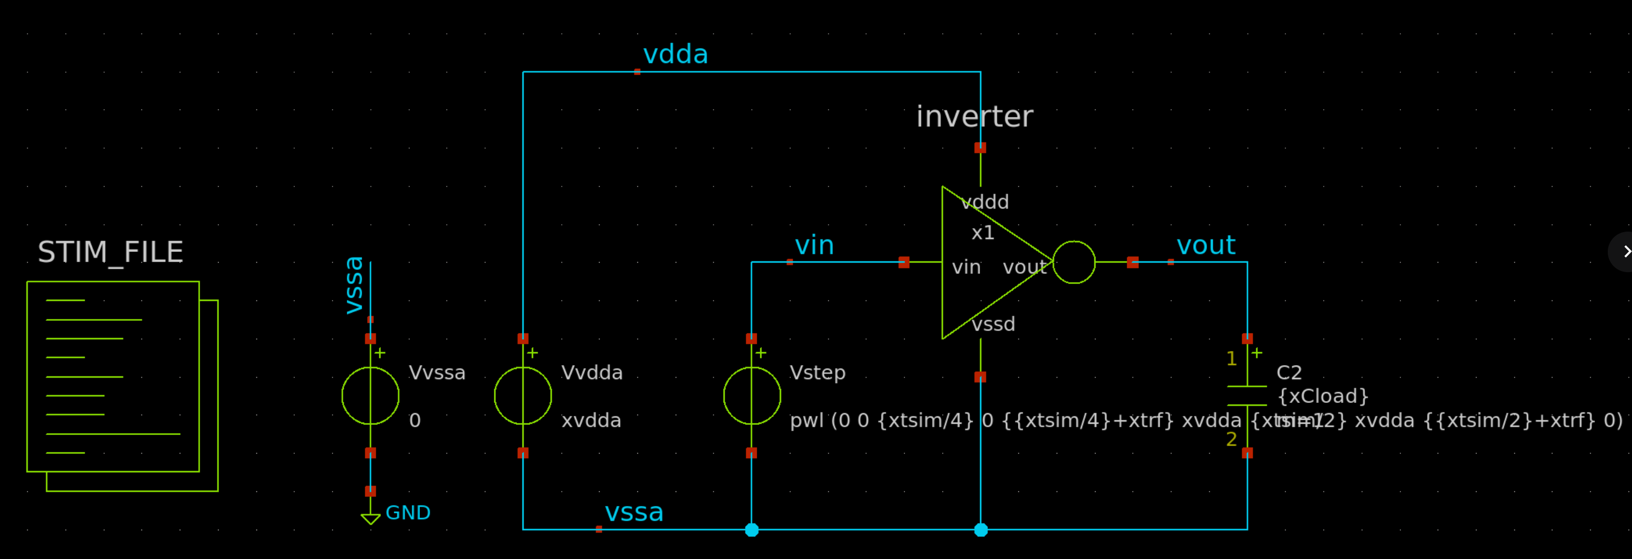
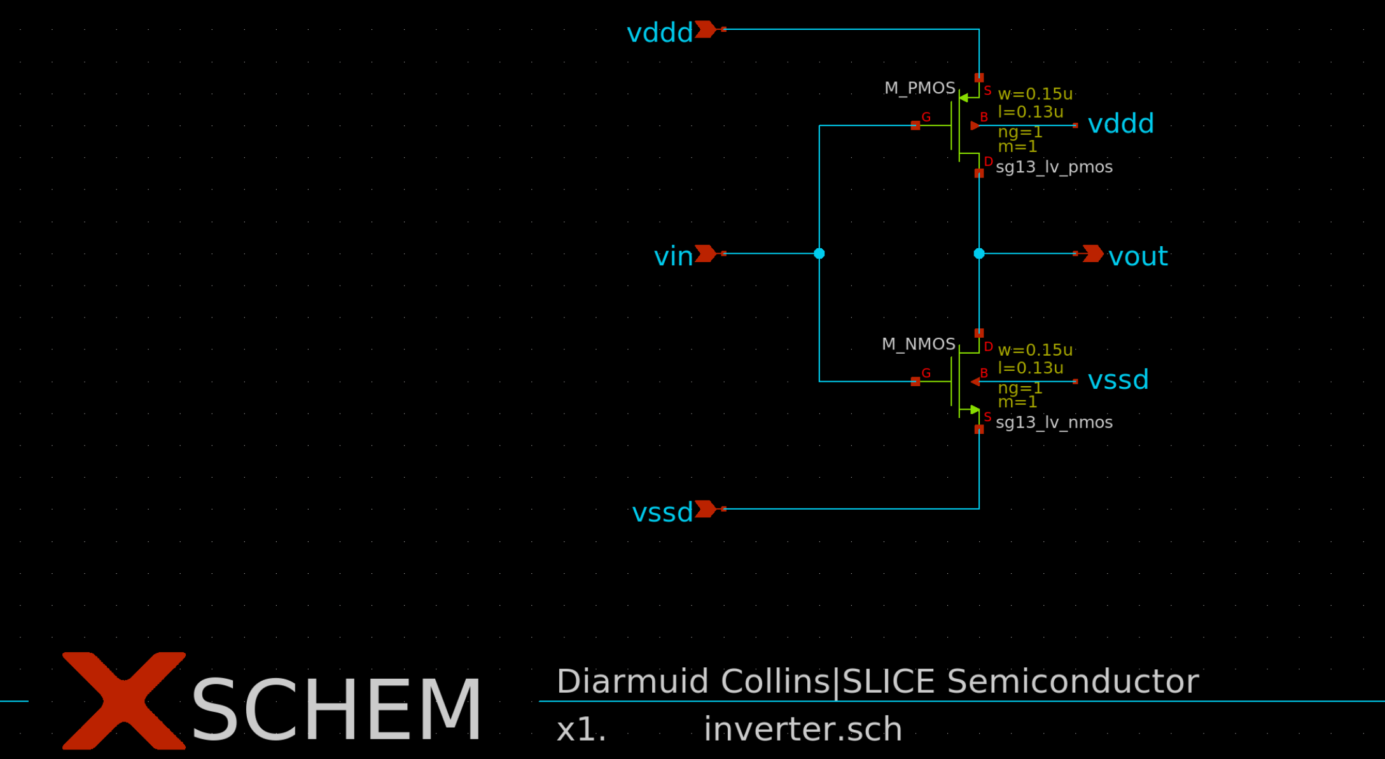
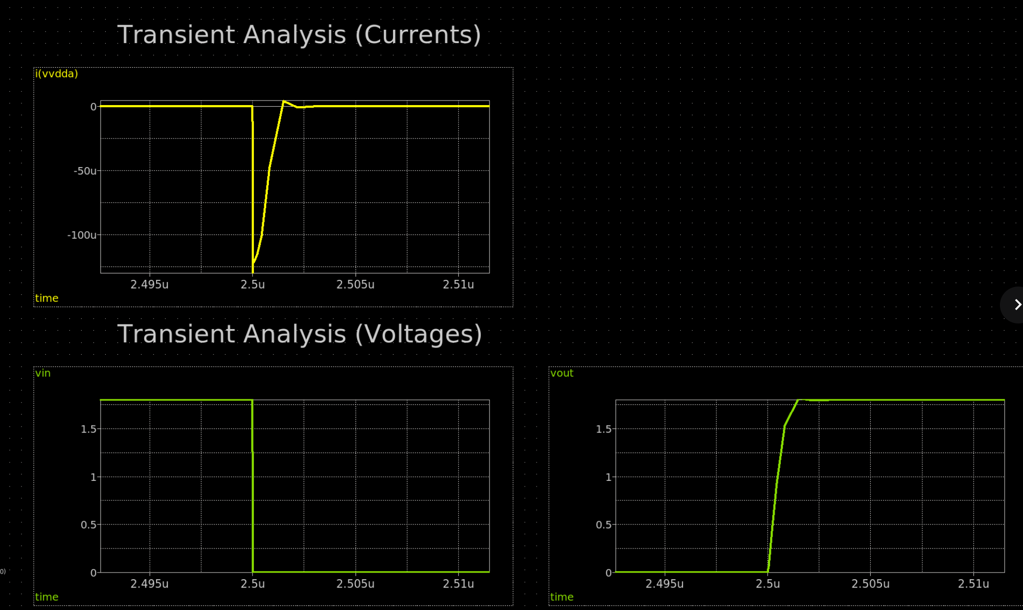
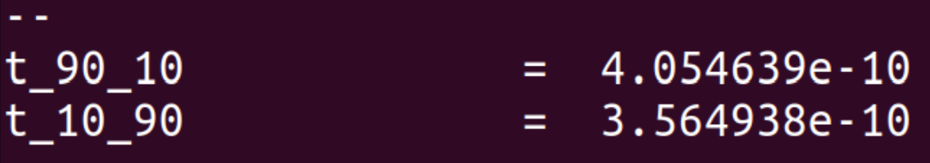
Schematic Entry + Simulation
Xschem used for schematic entry, ngspice used for simulation
Tb location: https://github.com/SLICESemiconductor/OpenSourceTool_Examples/tree/main/Inverter_testcase
Xschem also used for waveviewer
Rise / fall time
measures used to
compare pre / post
layout results

Slide 4
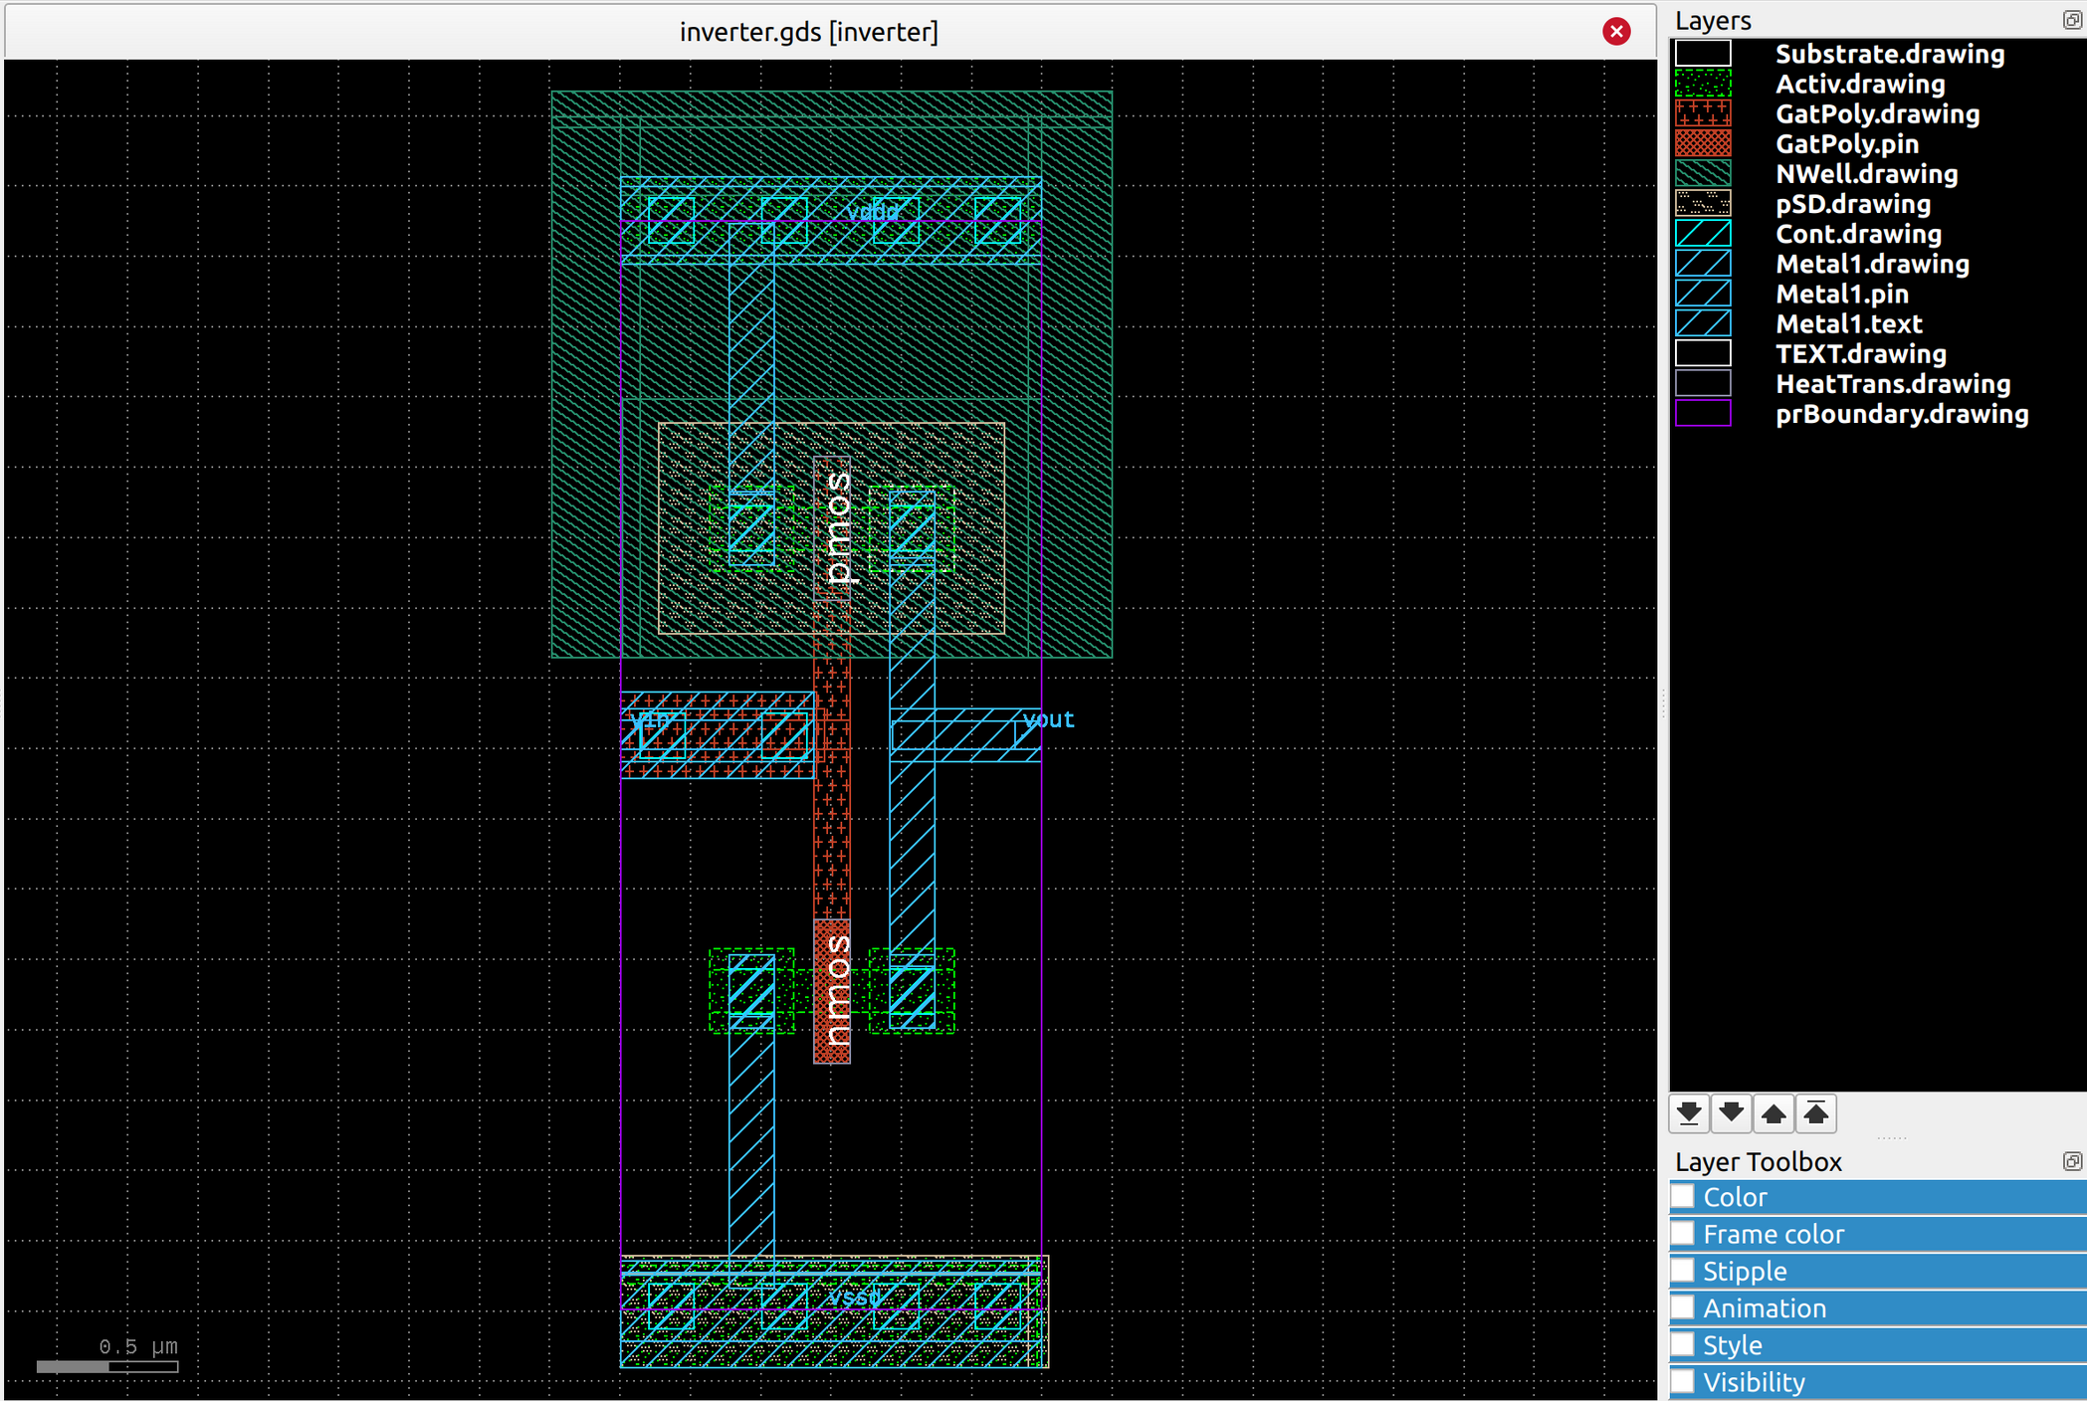
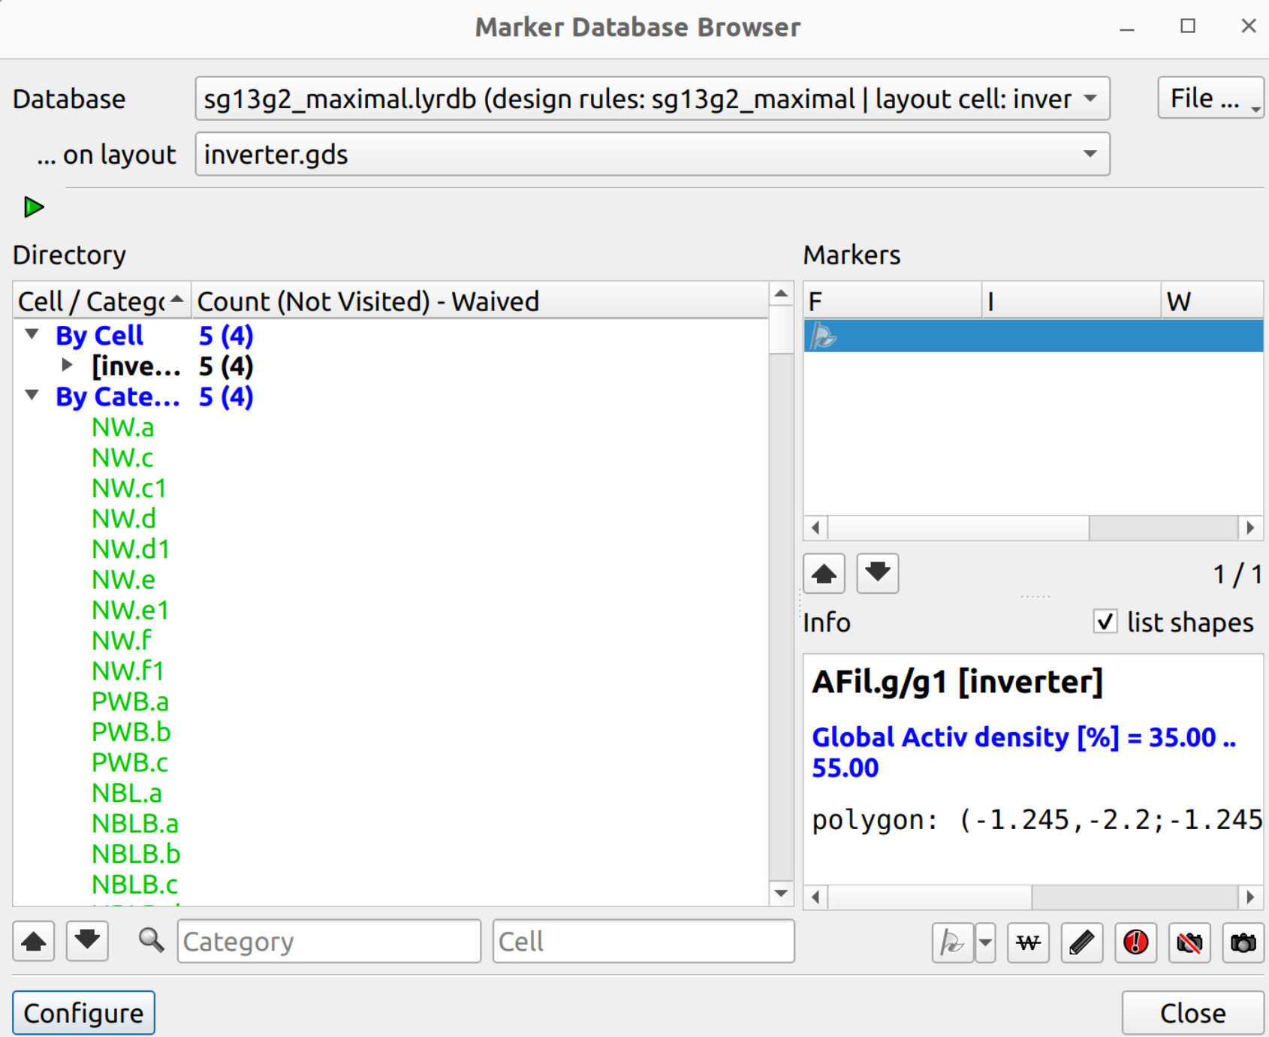
Layout Entry + DRC
Layout/DRC done in klayout (installation/usage details found at github link on slide 2)
Good klayout/ihp layout intro tutorial found at: https://www.youtube.com/watch?v=40qe4hXG6Kk
Note however, he doesn’t tie off the bulks in this video
DRC rules contained at: $PDK_ROOT/ihp-sg13g2/libs.doc/doc/SG13G2_os_layout_rules.pdf
Only remaining DRC’s should be density ones

Slide 5
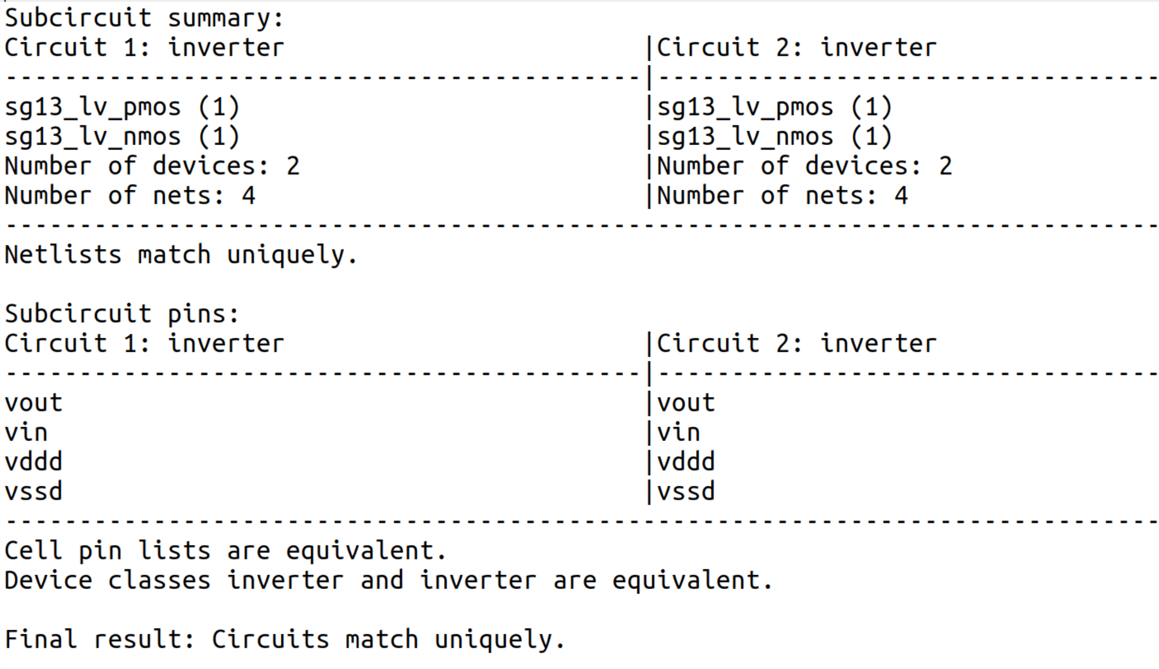
LVS
LVS initially done using klayout - KLVS (installation/usage details found at github link on slide 5)
KLVS is very difficult to debug so only used to generate the <cellname>_extracted.cir file
This file is then used by netgen for
LVS (installation/usage details
found at github link on slide 5)
Netgen used since it is faster,
more reliable (at present anyway)
and easier to debug
Netgen outputs from the
comp.out file are easily readable
as shown:
Sadly no ‘Calibre’ happy face
is produced ☹!

Slide 6
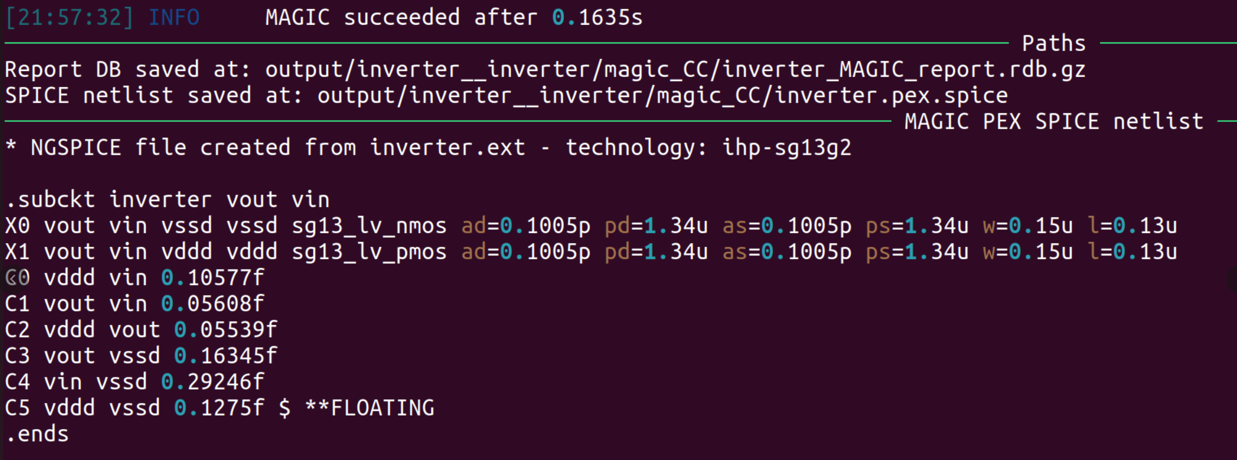
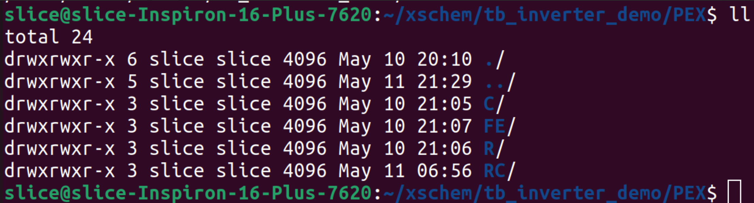
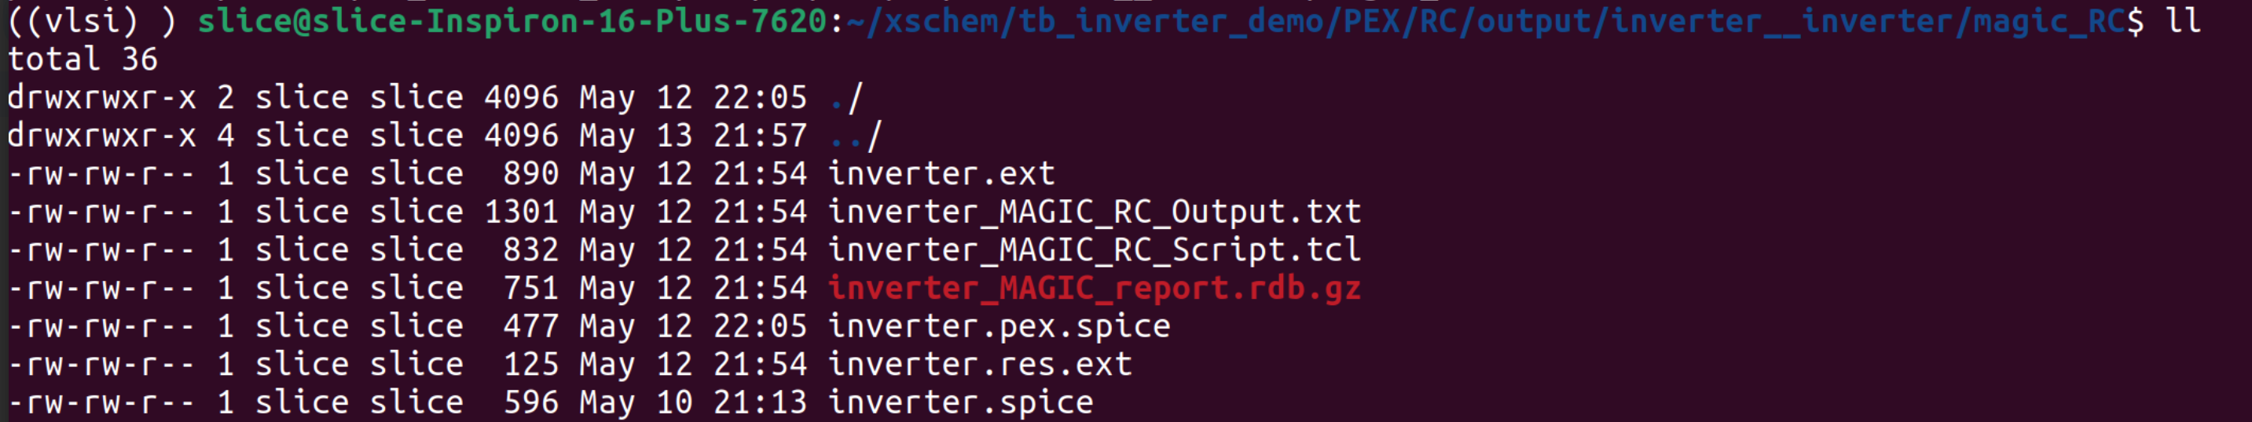
PEX
Run using KPEX (installation/usage details found at github link on slide 5)
Excellent tool documentation at: https://martinjankoehler.github.io/klayout-pex-website/doc/doc.html
Run in virtual python3 environment using magic extraction engine
Can be used to extract RC/C/R as standard. RC extracted netlist shown below
Advised to create directories for each extraction type (RC/R/C)
Extracted netlist contained inside
each dir as <cellname>.pex.spice

Slide 7
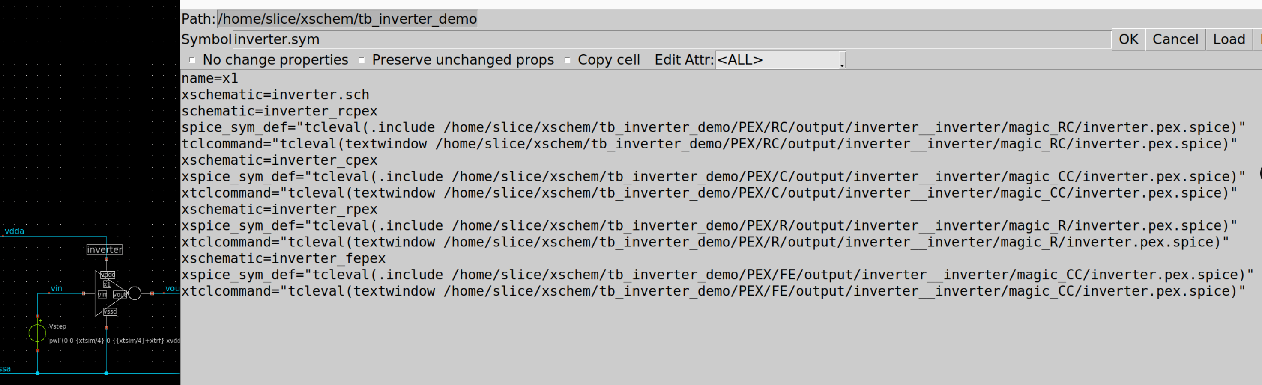
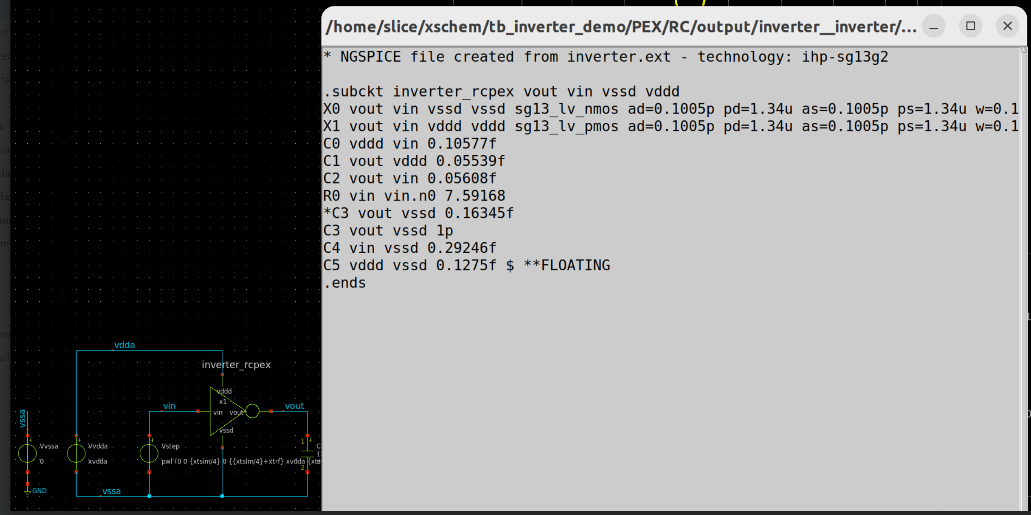
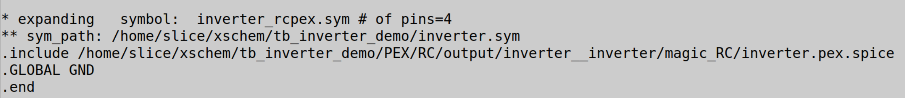
PEX Simulation
Use symbol properties as a config
editor
Instantiate each PEX view as
shown below (full details found
at github link on slide 5)
Precede unwanted views/lines with
an ‘x’
Select symbol and hit ctrl+H to verify
The correct PEX view has been selected
Further verification possible by confirming
the file at the end of the netlist is the correct PEX view
Then run sim as normal
Note: I have manually added 1pF of cap between vout and vssd. This is purely to show the impact of parasitics (next slide)

Slide 8
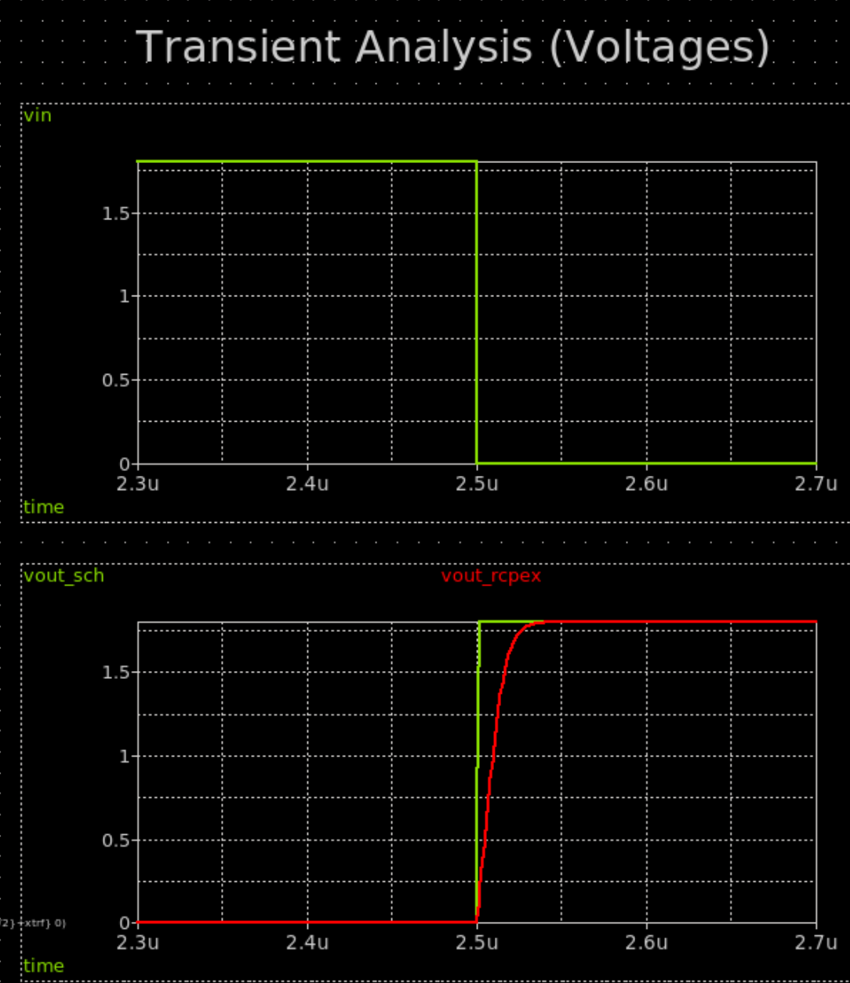
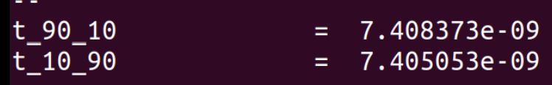
PEX Simulation Results
Waveforms clearly show the increased rise time due to
layout parasitics (the 1pF cap manually added to the
PEX netlist, as described on slide 6)
This is quantified by comparing the rise and fall times
as below:
SCH
PEX

Slide 9
Outstanding issues (some)
Cannot exclude nets to extract using magic extraction engine
Setting a threshold which specifies the min resistance to extract not implemented in kpex
Kpex extracted netlists do not include pwr/gnd pin names (must be manually added)

